Slide 1
Kleene’s Theorem Part III
BSCS
BSSE

Slide 2
Kleene’s Theorem Part III
Statement:
If the language can be expressed by a RE then there exists an FA accepting the language.
(A) As the regular expression is obtained applying addition, concatenation and closure on the letters of an alphabet and the Null string, so while building the RE, sometimes, the corresponding FA may be built easily, as shown in the following examples

Slide 3
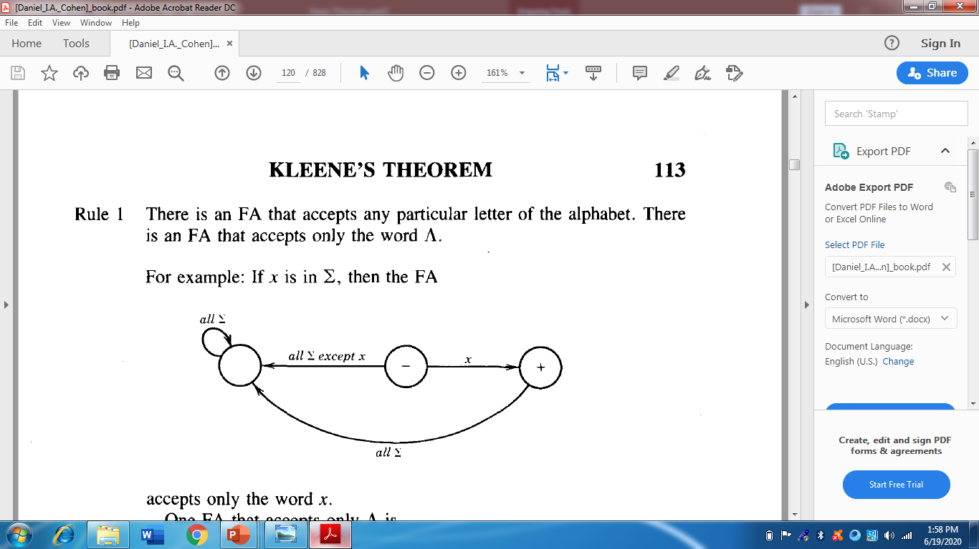

Slide 4
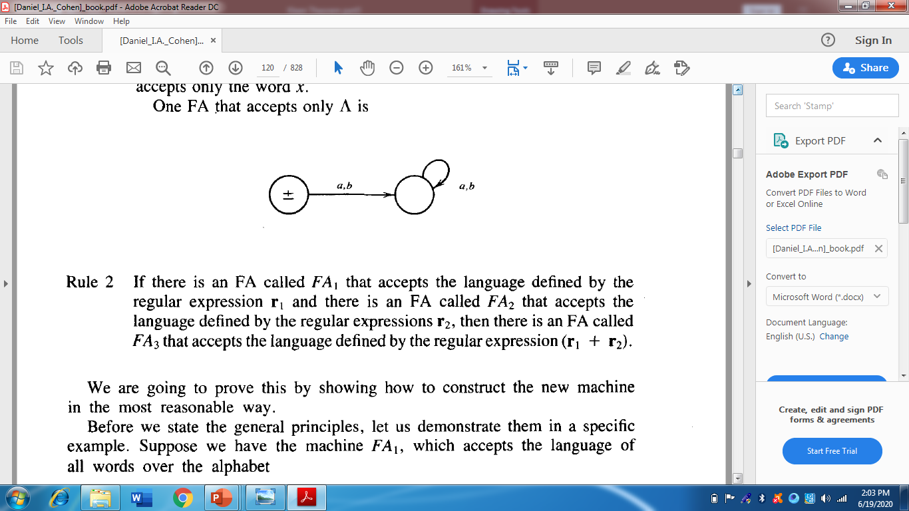

Slide 5

Kleene’s Theorem Part III Continued …
(B) As, if r1 and r2 are regular expressions then their sum, concatenation and closure are also regular expressions, so an FA can be built for any regular expression if the methods can be developed for building the FAs corresponding to the sum, concatenation and closure of the regular expressions along with their FAs. These three methods are explained in the following discussions

Slide 6
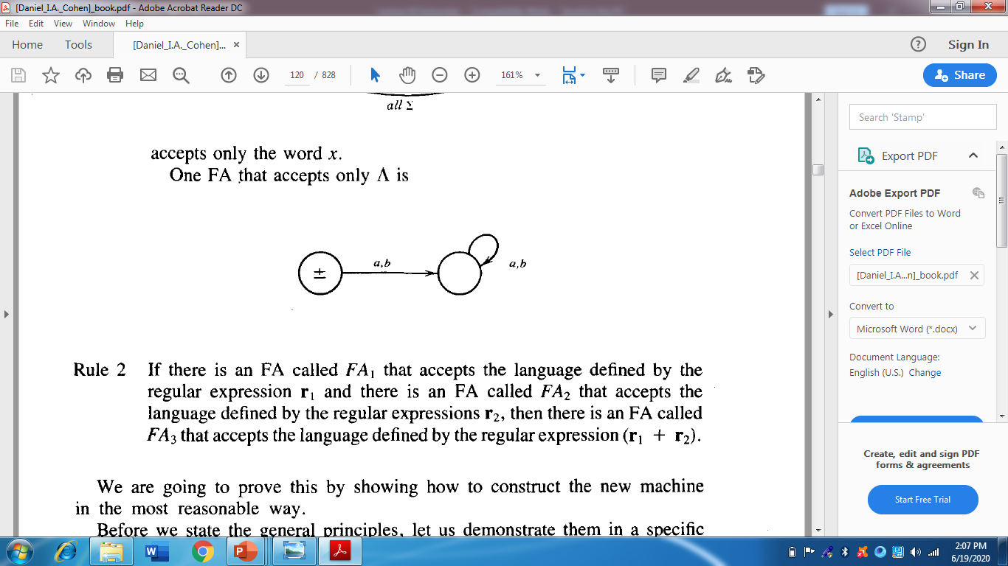
Union of two FAs:

Slide 7
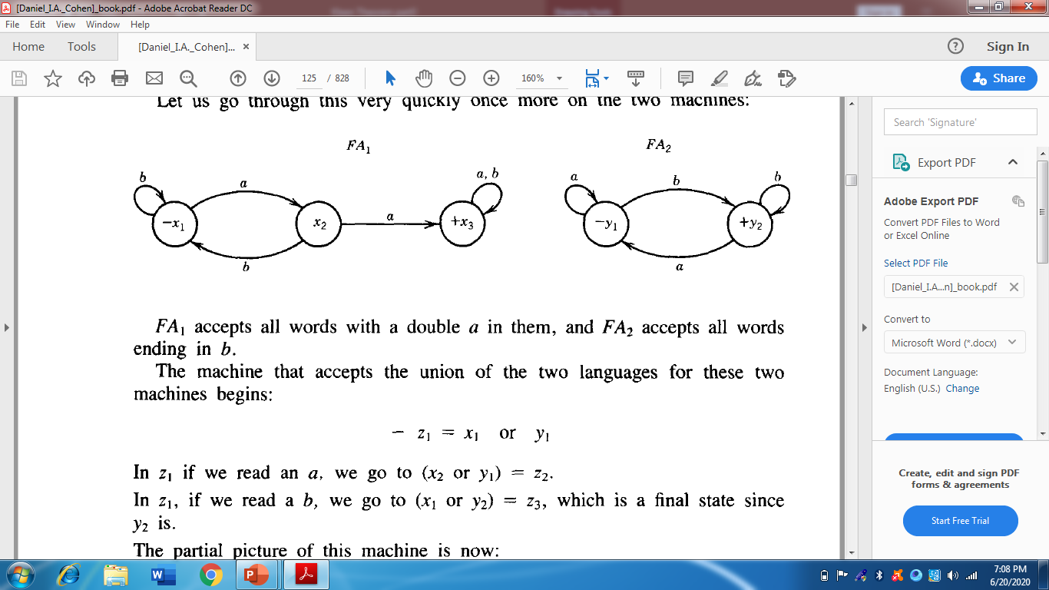
Example
Let r₁ = (a+b)*aa(a+b)* defines L₁ and the FA₁ be
r₂ =(a+b)*b defines L₂ and FA₂ be

Slide 8
Sum of two FAs Continued
Let FA₃ be an FA corresponding to r₁+ r₂, then the initial state of FA₃ must correspond to the initial state of FA₁ or the initial state of FA₂.
Since the language corresponding to r₁+ r₂ is the union of corresponding languages L₁ and L₂, consists of the strings belonging to L₁or L₂ or both, therefore a final state of FA₃ must correspond to a final state of FA₁ or FA₂ or both.

Slide 9
Sum of two FAs Continued …
Since, in general, FA₃ will be different from both FA₁ and FA₂, so the labels of the states of FA₃ may be supposed to be z₁,z₂, z₃, …, where z₁ is supposed to be the initial state. Since z₁ corresponds to the states x₁ or y₁, so there will be two transitions separately for each letter read at z₁. It will give two possibilities of states either z₁ or different from z₁. This process may be expressed in the following transition table for all possible states of FA₃.

Slide 10
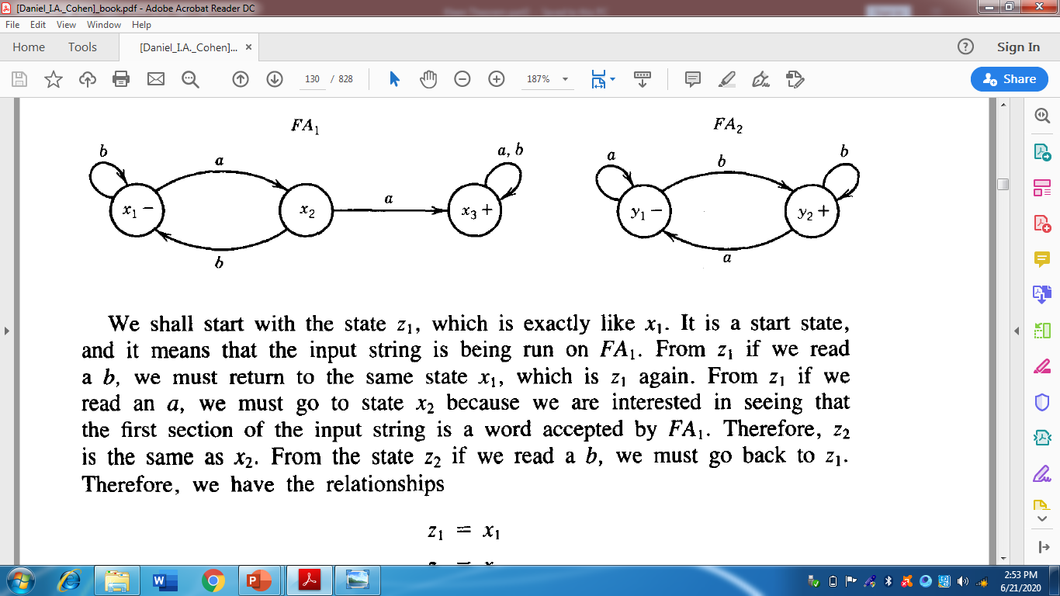
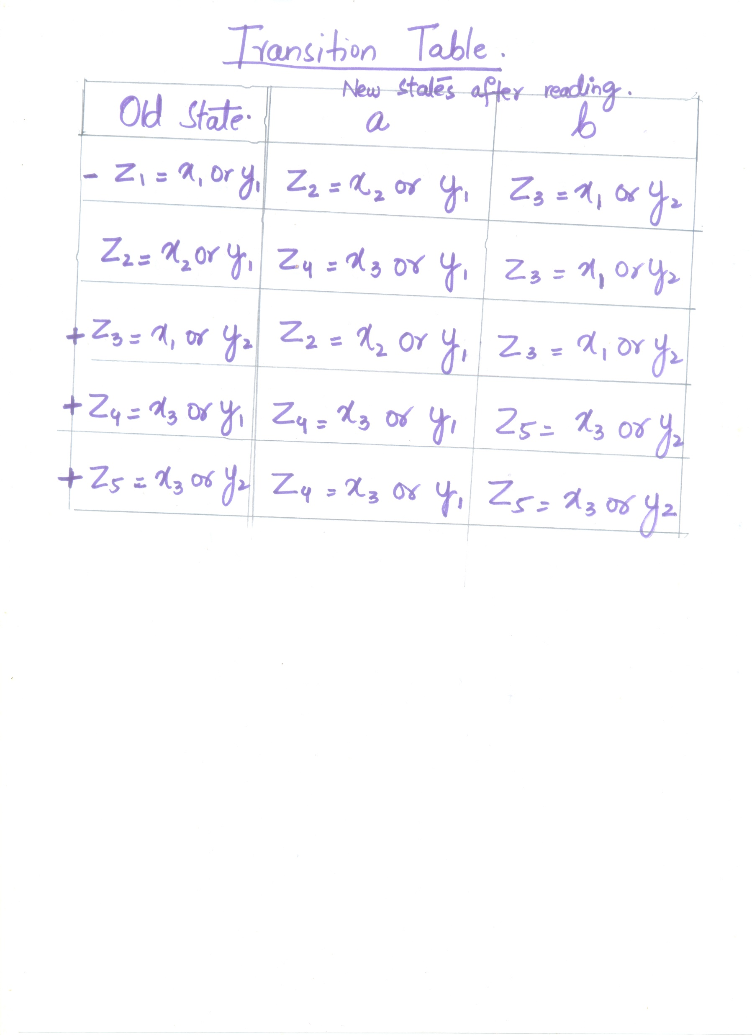

Slide 11
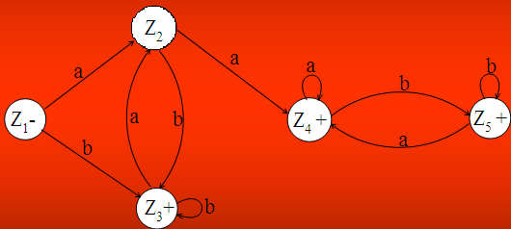
Example continued …
RE corresponding to the above FA may be
r₁+r₂ = (a+b)*b + (a+b )*aa(a+b )*

Slide 12
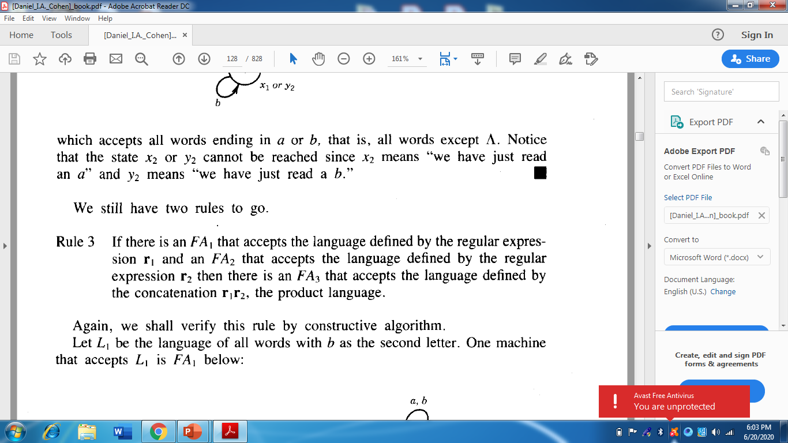
Concatenation of two FAs:

Slide 13
Concatenation of two FAs Continued …
Let FA₃ be an FA corresponding to r₁r₂ , then the initial state of FA₃ must correspond to the initial state of FA₁ and the final state of FA₃ must correspond to the final state of FA₂ . Since the language corresponding to r₁r₂ is the concatenation of corresponding languages L₁ and L₂ , consists of the strings obtained, concatenating the strings of L₁ to those of L₂ , therefore the moment a final state of first FA is entered, the possibility of the initial state of second FA will be included as well.

Slide 14
Concatenation of two FAs Continued …
Since, in general, FA₃ will be different from both FA₁ and FA₂ , so the labels of the states of FA₃ may be supposed to be z₁,z₂, z₃, …, where z₁ stands for the initial state. Since z₁ corresponds to the states x₁ , so there will be two transitions separately for each letter read at z₁ . It will give two possibilities of states which correspond to either z₁ or different from z₁ . This process may be expressed in the following transition table for all possible states of FA_{3 .}

Slide 15
Example
Let r₁ = (a+b)*aa(a+b)* defines L₁ and the FA₁ be
r₂ =(a+b)*b defines L₂ and FA₂ be

Slide 16
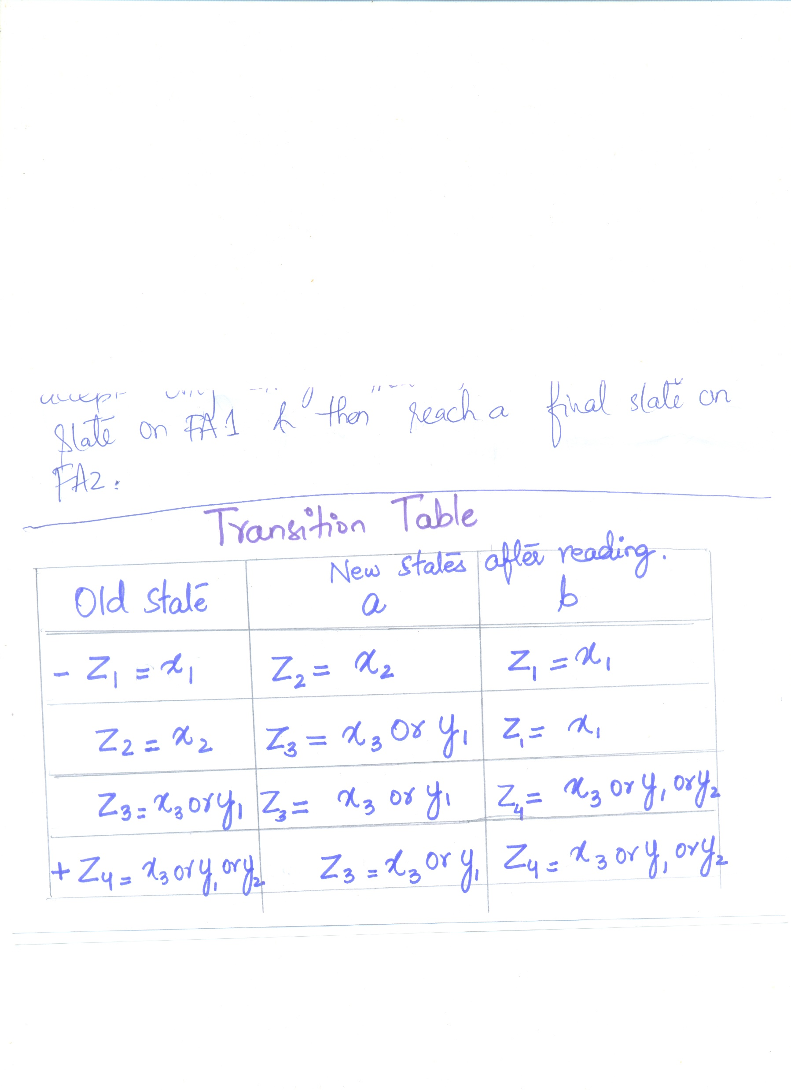

Slide 17
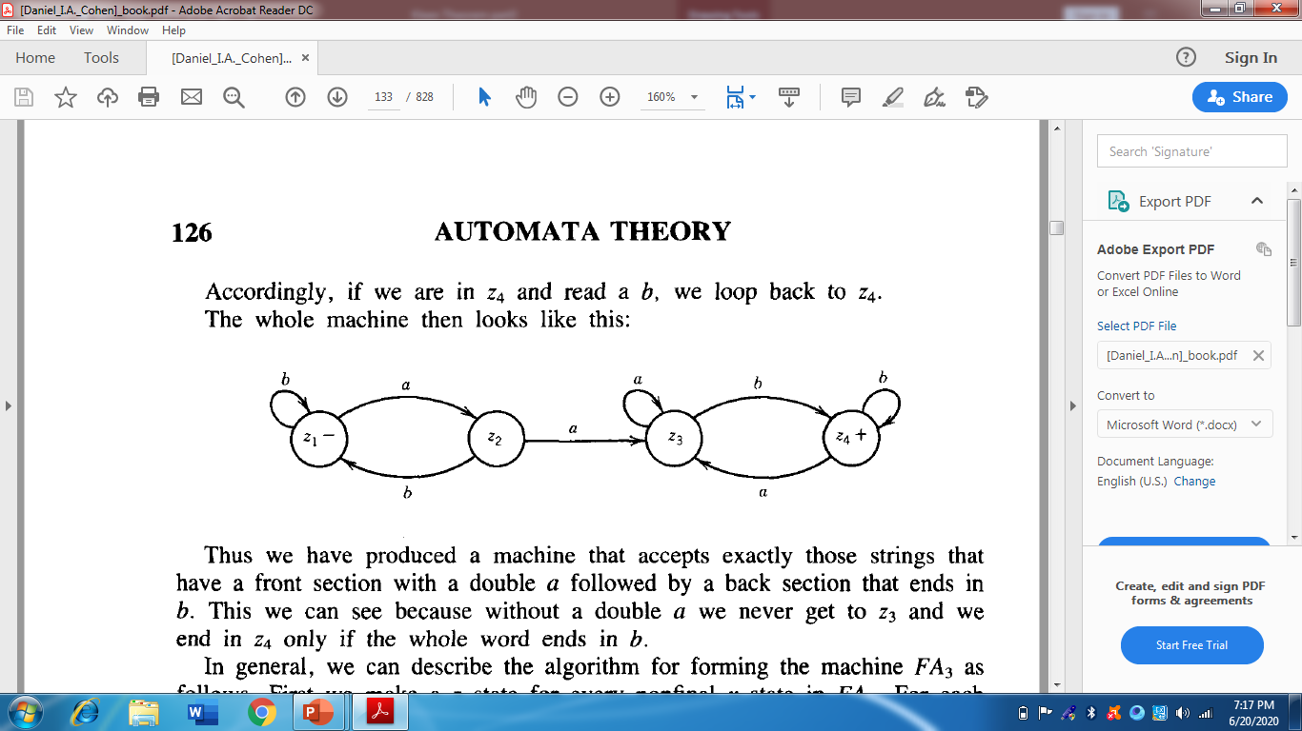
Example continued …

Slide 18
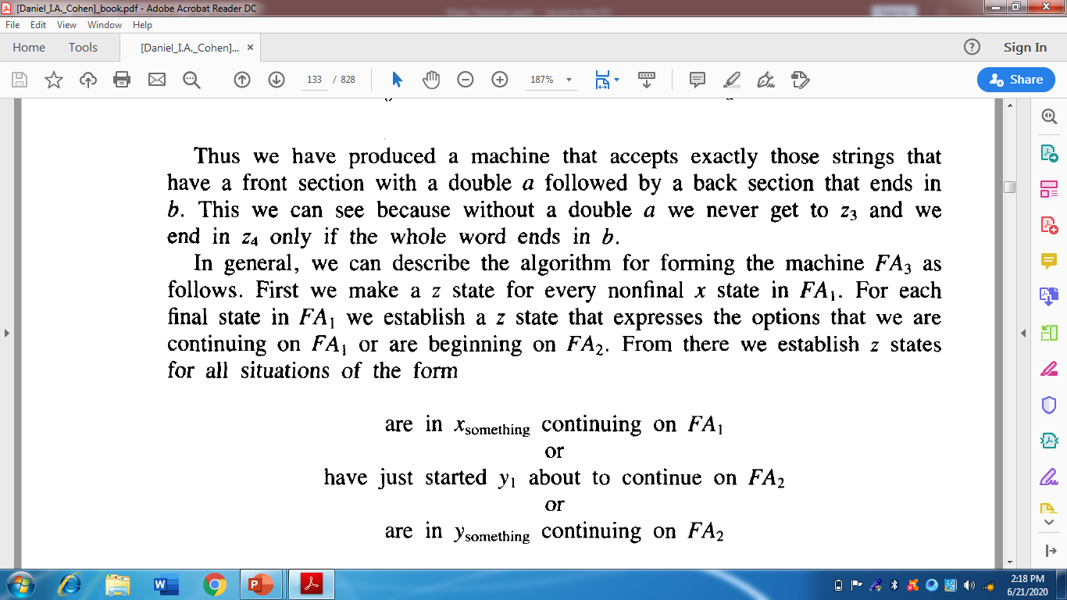

Slide 19
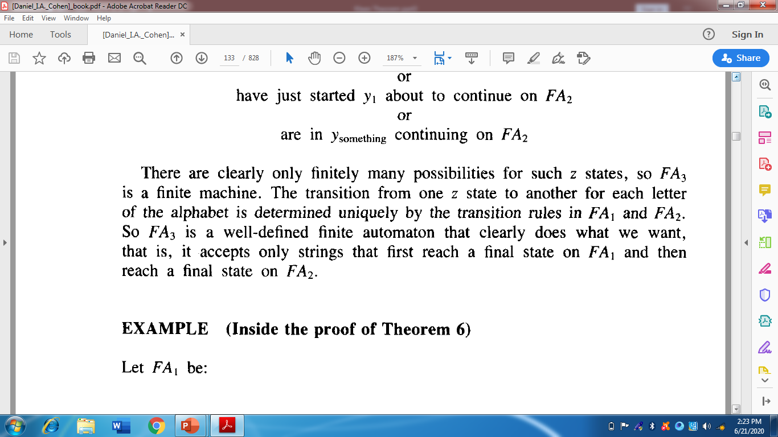

Slide 20
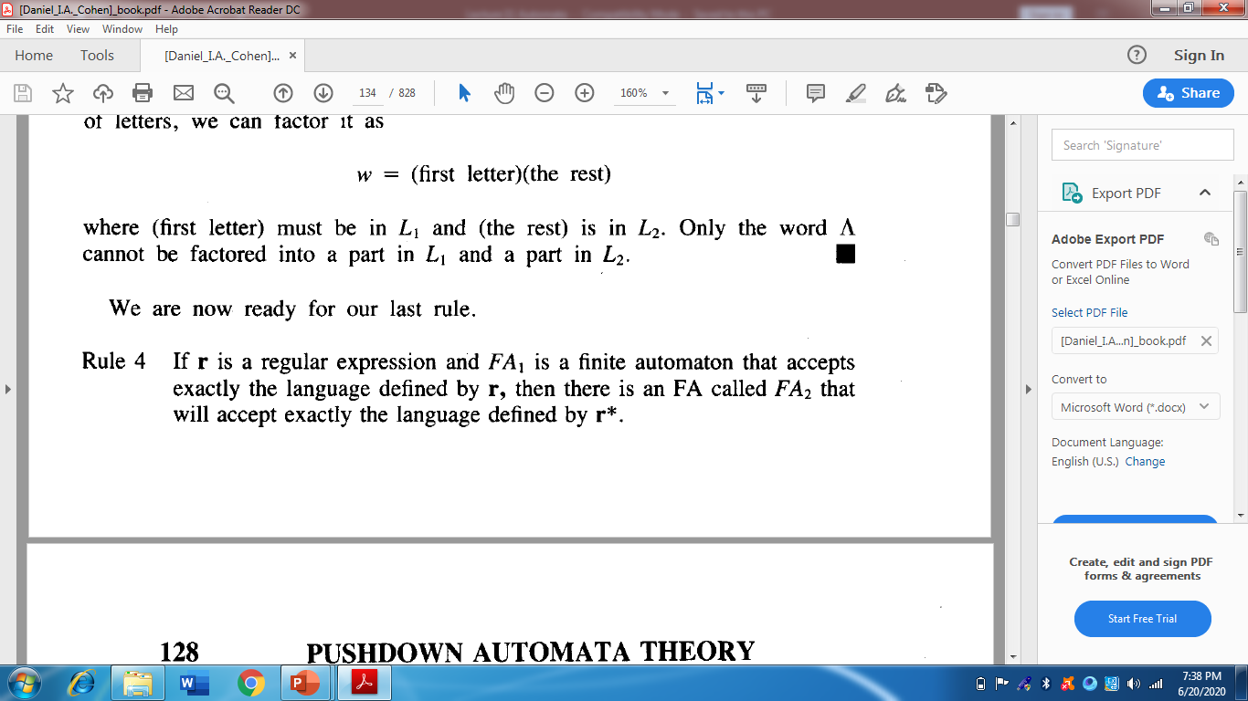
(Closure of an FA)

Slide 21
Closure of an FA
Building an FA corresponding to r*, using the FA corresponding to r.
It is to be noted that if the given FA already accepts the language expressed by the closure of certain RE, then the given FA is the required FA. However the method, in other cases, can be developed considering the following example.
Closure of an FA, is same as concatenation of an FA with itself, except that the initial state of the required FA is a final state as well.
Here the initial state of given FA, corresponds to the initial state of required FA and a non final state of the required FA as well. Means initial state of given FA will correspond to two sates in required FA.

Slide 22
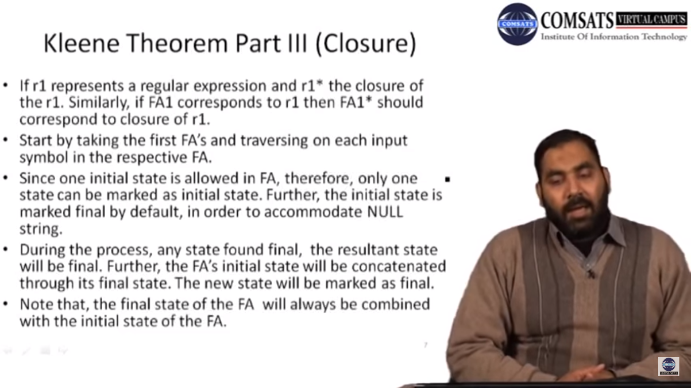

Slide 23
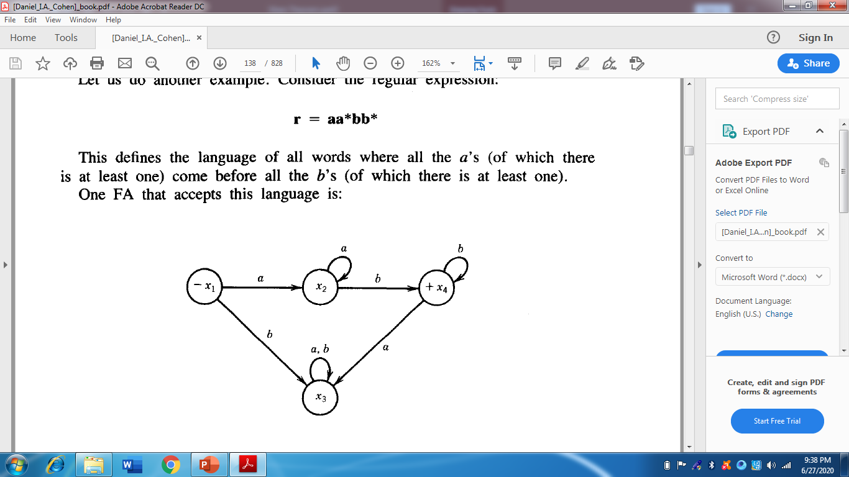
Example

Slide 24
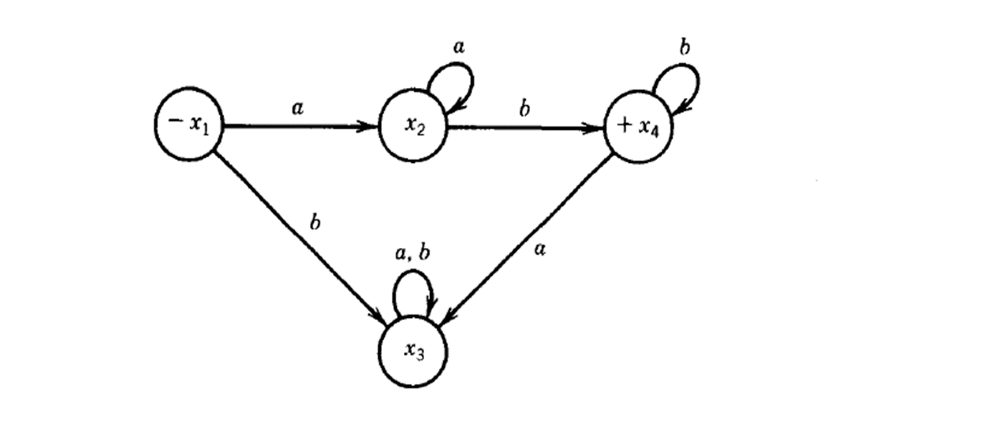
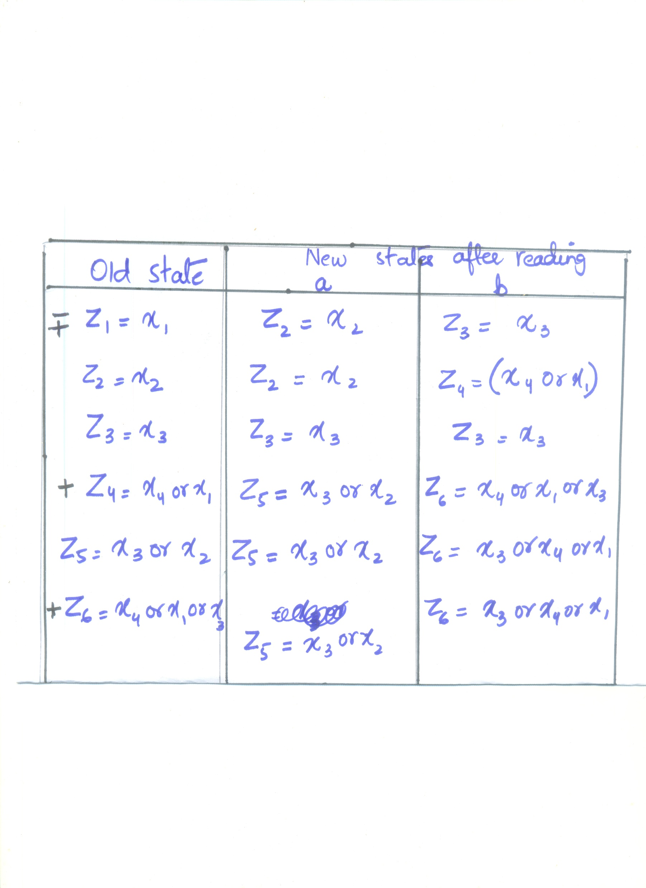

Slide 25
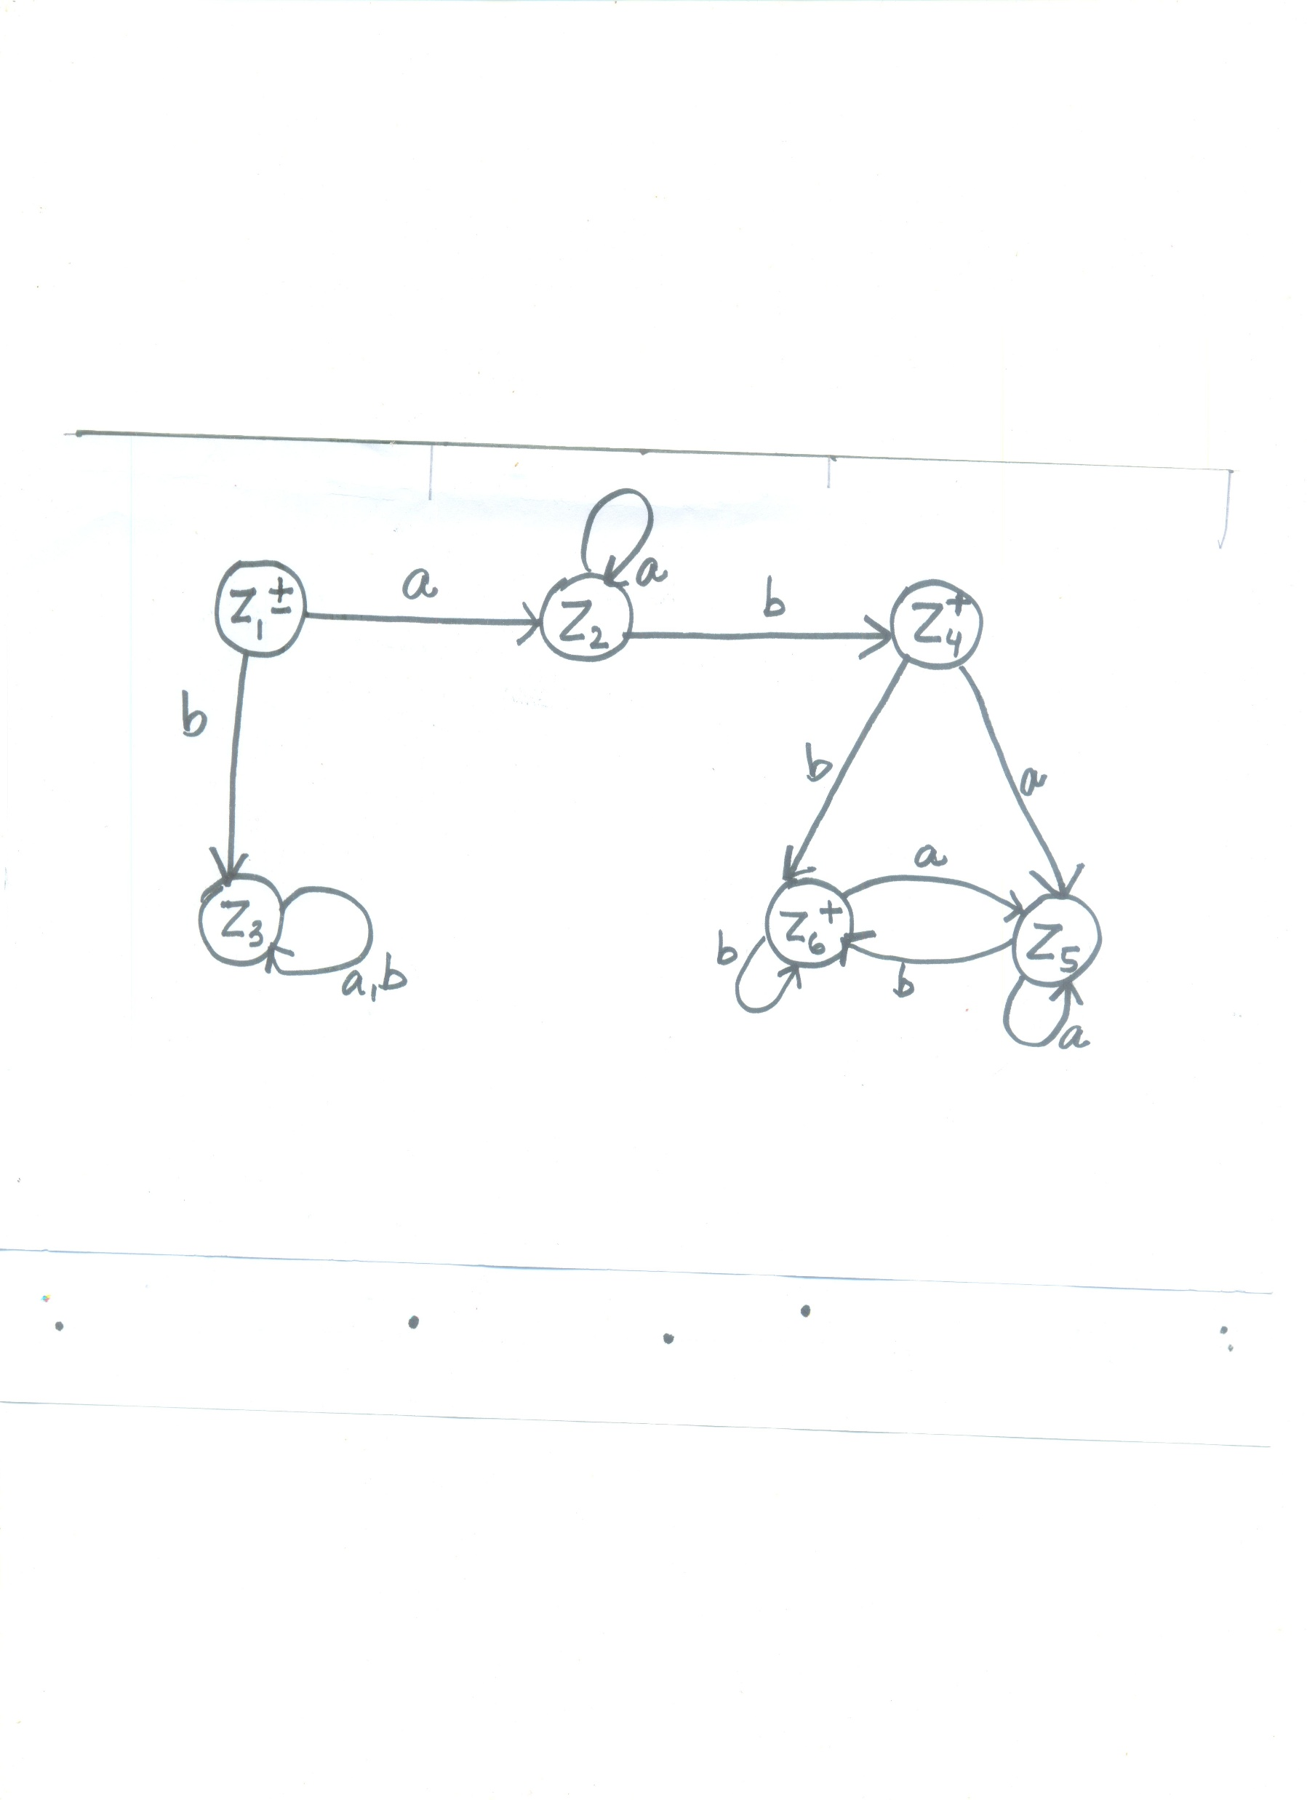

Slide 26
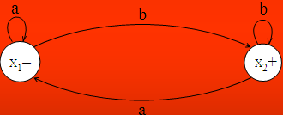
Example 2
Let r=(a+b)*b and the corresponding FA be
then the FA corresponding to r* may be determined as under

Slide 27
Example continued …
Old states | New states after reading
 | a | b
z₁ - + ≡ x₁ | x₁ ≡ z₂ | (x₂, x₁) ≡ z₃
Non-final z₂ ≡ x₁ | x₁ ≡ z₂ | (x₂, x₁) ≡ z₃
z₃ + ≡ (x₂, x₁) | x₁ ≡ z₂ | (x₂, x₁) ≡ z₃
The corresponding transition diagram may be as under

Slide 28
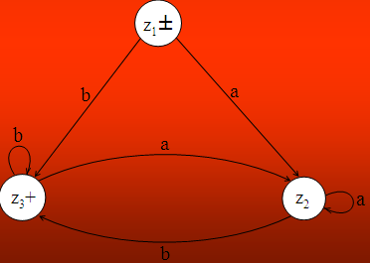
Example continued …

